Slide 1
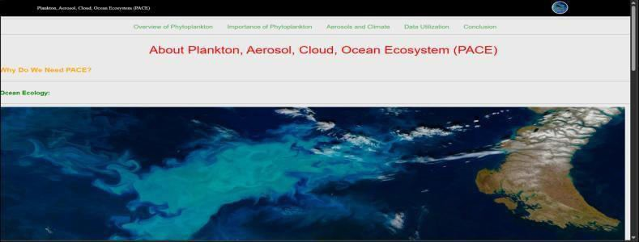
TEAM NAME : AeroOcean - Alliance
TEAM MEMBERS:
Prajwal PGR
Deepika NP
Manoja SP
Vaishnavi Shri
Anagha Prabhu
Varun Vilas

Slide 2


Space App Challenge PACE: An Overview
Introducing the cutting-edge Space App Challenge PACE, a pioneering initiative that harnesses the power of technology to address global challenges.

Slide 3
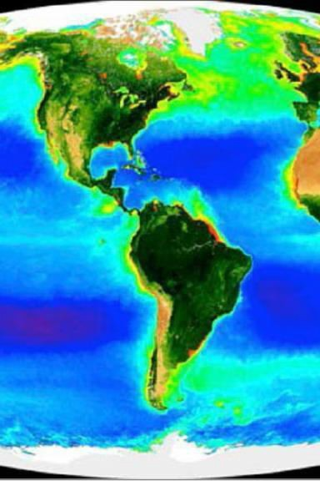
The Challenge: Defining the Problem
1
Identifying Key Issues
Pinpointing the most pressing problems facing our planet and communities.
2
Gathering Data
Leveraging diverse data sources to gain a comprehensive understanding.
3
Understanding the NASA PACE data
We'll explore how this data gives us a clearer picture of the key issues so we can develop targeted, impactful solutions.

Slide 4
USER EXPERIENCE :
With our website you can easily understand what is PACE(Phytoplankton Aerosal Cloud Ocean Ecosystem) and be able to visualize how the PACE data helps us understand the ocean ecosystem and further help in understanding our surrounding.
The complex data from NASA has been simplified and visualized using some of the PACE data from NASA.

Slide 5
IMPLEMENTING SPACE DATA:
The NASA data has been really helpful in coming up with our solution to create a easy lesson plan on PACE as our challenge had expected. The PACE visuals are really helpful as they help us understand the required graph of each place in a simple yet informative

